Slide 1
Unit 5 MEASURES FOR PERFORMANCE EVALUATION OF ML ALGORITHMS

Slide 2
Performance measures of Classification
Before selecting a classification algorithm to solve a problem, we need to evaluating its performance. Confusion matrix is widely used for computing performance measures of classification algorithm.
A Confusion matrix is an N x N matrix used for evaluating the performance of a classification model, where N is the number of target classes.
The matrix compares the actual target values with those predicted by the machine learning model. This gives us a holistic view of how well our classification model is performing and what kinds of errors it is making.

Slide 3
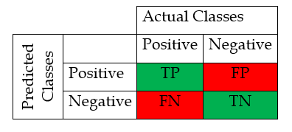
For a binary classification problem, we would have a 2 x 2 matrix as shown below with 4 values:
True Positive(TP): It represents correctly classified positive classes. Both actual and predicted class are positive here.
False Positive (FP): It represents incorrectly classified positive classes. These are the positive classes predicted by the model that were actually negative. This is called Type I error.

Slide 4
True Negative(TN): It represents correctly classified Negative classes. Both actual and predicted class are negative here.
False Negative (FN): It represents incorrectly classified negative classes. These are the negative classes predicted by the model that were actually positive. This is called Type II error.
Four widely used performance measures used for evaluating classification models are: Accuracy, Recall, Precision, F1-score.
Accuracy: It is the percentage of correct predictions made by the model and is given as below:

Slide 5
Precision: It is percentage of predicted positives that are actually positive and is given by:
Recall: It is the percentage of actual positives that are correctly classified by the model and is given as below:

Slide 6
F1-score: It is the harmonic mean of recall and precision. It becomes high only when both precision and recall are high. This score is given by:
Sensitivity-Specificity Metrics
Sensitivity refers to the true positive rate and summarizes how well the positive class was predicted.
Sensitivity=Recall = TP / (TP + FN)

Slide 7
Specificity
Specificity is the complement to sensitivity, or the true negative rate, and summarizes how well the negative class was predicted.
Specificity = TN / (FP + TN)

Slide 8
Receiver Operating Characteristic (ROC)
The acronym ROC stands for Receiver Operating Characteristic, a terminology coming from signal detection theory. The ROC curve was first developed by electrical engineers and radar engineers during World War II for detecting enemy objects in battlefields. They are now increasingly used in machine learning and data mining research.
TPR and FPR
Let a binary classifier classify a collection of test data. Let as before
TP = Number of true positives
TN = Number of true negatives
FP = Number of false positives
FN = Number of false negatives
Now we introduce the following terminology:

Slide 9
ROC(Receiver Operating Characteristic )

Slide 10
ROC space
We plot the values of FPR along the horizontal axis (that is , X-axis) and the values of TPR along the vertical axis (that is, y-axis) in a plane. For each classifier, there is a unique point in this plane with coordinates (FPR, TPR). The ROC space is the part of the plane whose points correspond to (FPR, TPR). Each prediction result or instance of a confusion matrix represents one point in the ROC space.
The position of the point (FPR, TPR) in the ROC space gives an indication of the performance of the classifier. For example, let us consider some special points in the space.
Special points in ROC Space
The left bottom corner point (0, 0): Always negative prediction:
A classifier which produces this point in the ROC space never classifies an example as positive, neither rightly nor wrongly, because for this point TP = 0 and FP = 0. it always makes negative predictions.

Slide 11
2. The right top corner point (1,1):Always positive prediction:
A classifier which produces this point in the ROC space always classifies an example as positive because for this point FN= 0 and TN=0. All positive instances are correctly predicted and all negative instances are wrongly predicted.
3. The left top corner point(0,1): Perfect prediction:
A Classifier which produces this point in the ROC space may be thought as a perfect classifier. It produces no false positives and no false negatives.
4. Points along the diagonal: Random performance:
Consider a classifier where the class labels are randomly guessed, say by flipping a coin. Then the corresponding points in the ROC space will be lying very near the diagonal line joining the points (0, 1) and (1, 1)

Slide 12
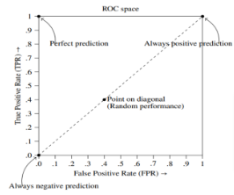

Slide 13
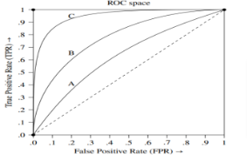
ROC Curve
In this case of certain classification algorithms the classifier may depend on a parameter. Different values of the parameter will give different classifiers and these in turn give different values to TPR and FPR. The ROC curve is the curve obtained by plotting in the ROC space the points (TPR, FPR) obtained by assigning all possible values to the parameter in the classifier

Slide 14
ROC curve
The closer the ROC curve is to the top left corner (0, 1) of the ROC space, the better the accuracy of the classifier. Among the three classifiers A, B, C with ROC curves as shown in Figure above, the classifier C is closed to the top left corner of the ROC space. Hence, among the three, it gives the best accuracy in prediction.

Slide 15
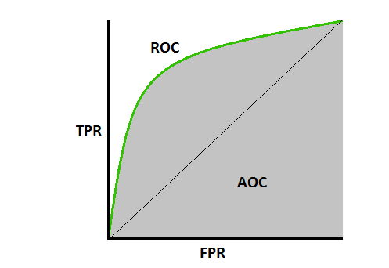
AUC: Area under the ROC Curve
If area under the ROC curve is higher, the better is the model performance.
If the curve is somewhere near the 50% diagonal line, it suggests that the model randomly predicts the output variable.

Slide 16
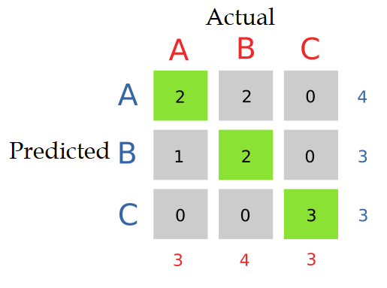
Evaluation Metrics for Multi-class Classification
If there are N number of classes confusion matrix is a NxN matrix. For example, for 3 classes confusion matric looks like below.

Slide 17
Then we need to calculate TP, FP, TN and FN for each class separately.
TP: Actual and predicted both same.
FP: Sum of all entries in the row except TP.
TN: sum of all entries in rows and columns except row and column of calculating class.
FN: Sum of all entries in the column except TP.
Example:
For Class A: TP=2, FP=2, TN=5, FN:1
For Class B: TP=2, FP=1, TN=5, FN:2
For Class C: TP=3, FP=0, TN=7, FN:0

Slide 18
Misclassification Costs
Misclassification costs are the penalties associated with making incorrect predictions in a classification problem.
In binary classification, there are two possible outcomes: true positive (TP) and true negative(TN) or false positive (FP) and false negative(FN).
The misclassification costs are typically represented in a cost matrix, where each cell represents the cost of making a particular type of error.
Confusion matrix forms the basis for the other types of metrics.
The error rate can also be calculated from the confusion matrix as the sum of incorrect cells of the table (false positives and false negatives) divided by all cells of the table.
Error Rate = (FP + FN) / (TP + FN + FP +TN)

